Slide 1


The Pursuit of Happiness Factors
: What Factors Correlate More with Happiness?
Paul Dean, Soobin Hwang, Mark Gatongay, Seunghwa Jun
UofTSTG201905DATA3 ｜ July 16, 2019

Slide 2

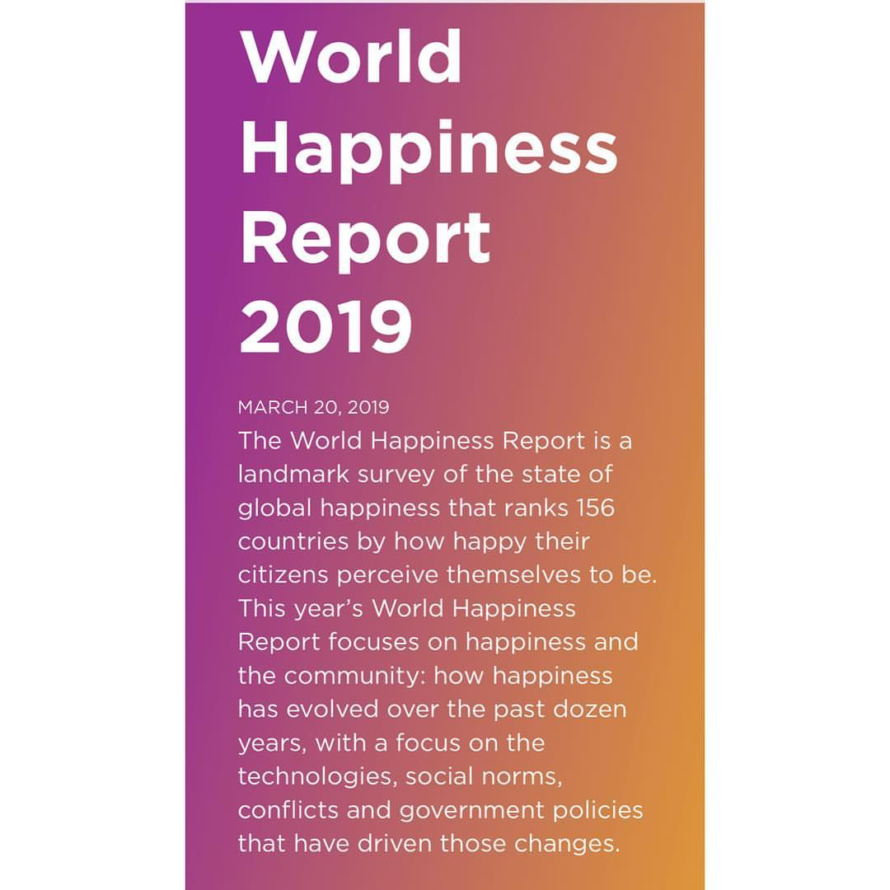
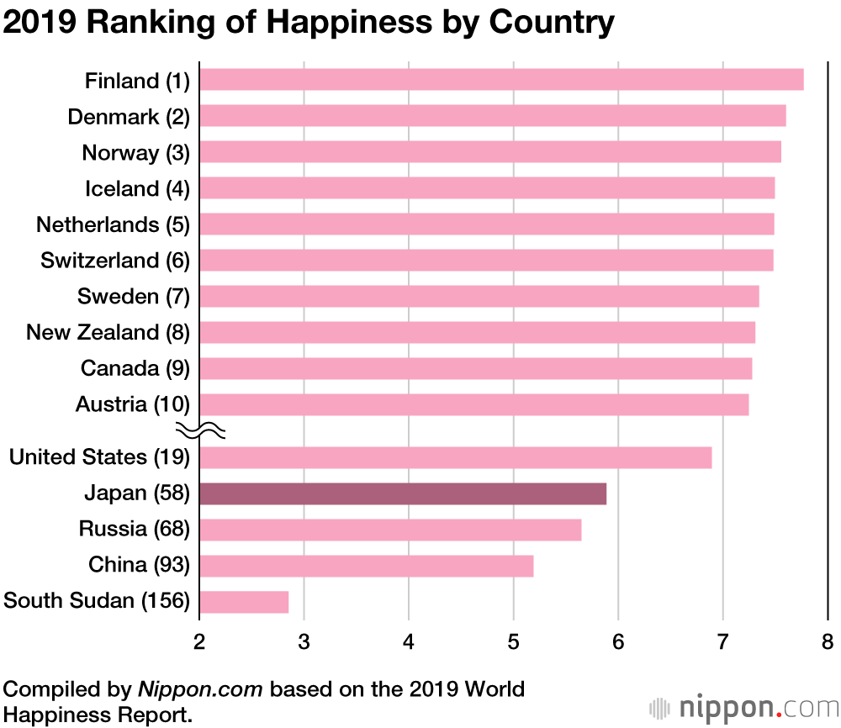
Motivation
It all started with one report,
“The World Happiness Report 2019(Gallup).”
Hmm.. Why some countries are happy and others are miserable? What factors correlate more with happiness?
Wait, it’s great for practicing what we’ve learned so far!

Slide 3
Introduction
‘The World Happiness Report’ is a landmark survey of the state of global happiness that ranks 156 countries by how happy their citizens perceive themselves to be.
So, we tried to find important factors that are strongly
correlated to the level of happiness among11 indices:
1) GDP per capita, 2) Healthy life expectancy,
3) Social Support, 4) Freedom, 5) Generosity,
6) Trust in government, 7) Unemployment Rate,
8) Birth Rate, 9) Obesity Rate, 10) Population Density,
and 11) Weather
“11 indices? Are you kidding?”
“ Yeah.. They are Eleven.. And we did it!”

Slide 4
Data
“11 indices mean… Bunch of Data!!”
Many websites were searched through….
: Kaggle, WorldHappiness.report, CIA, Data.World,
WorldBank, OECD, WorldEconomicForum, Gallup, etc.
Three APIs utilized…
: World Bank API, OpenWeatherMap API, Google Maps
As a result,
Roughly 30 csv files were downloaded and created…!

Slide 5
Data Clean Up & Exploration
Data Clean Up & Format
: Pandas, Jupyter Notebook, Excel
Data Analysis
: Matplotlib, SciPy, Numpy, Pandas,
Pandas.plotting(scatter matrix, table)
Visualization
: Line Graph, Bar Graph, Pie Graph, Box Plot,
Scatter Plot, Scatter Matrix, Geographical Heatmap

Slide 6
Questions (contents)
Ι
What are the Characteristics of
‘Happy’ vs. ‘Miserable’ Countries?
Ⅱ
What ‘Factors’ Correlate More
With the Level of Happiness?
Ⅲ
Why and How are the ‘Top Two Factors’
Strongly Related to Happiness?

Slide 7
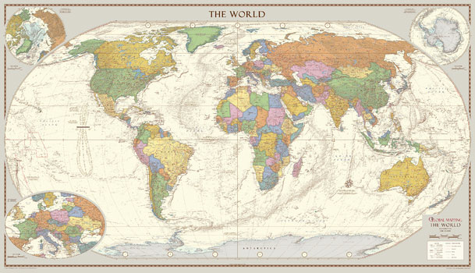
I. What are the Characteristics of
‘Happy’ vs. ‘Miserable’ Countries?

Slide 8
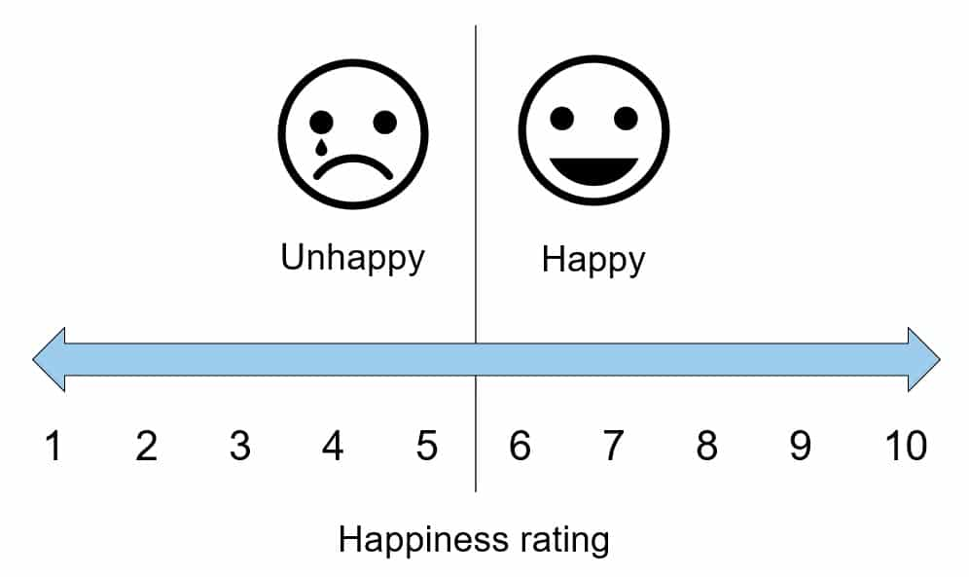
How ‘Happy’ Are You??
Let’s start off with rating your current life on 1 to 10 scale.

Slide 9
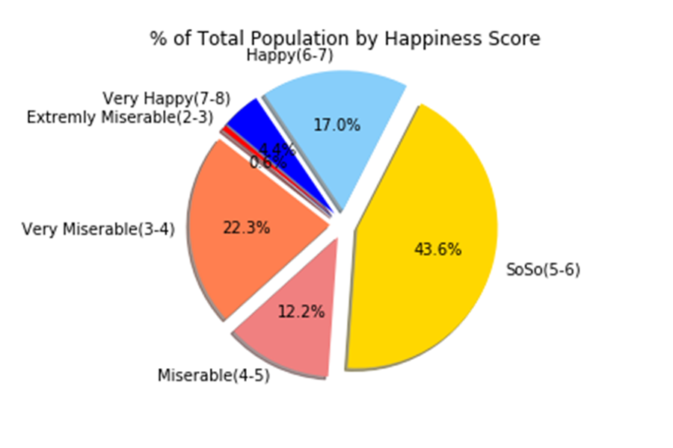
What about the World?
Where do you belong?
% of Total Population by Happiness Score
Data : Gallup(2018) ‘World Happiness Report’ / CIA ‘World Population’

Slide 10
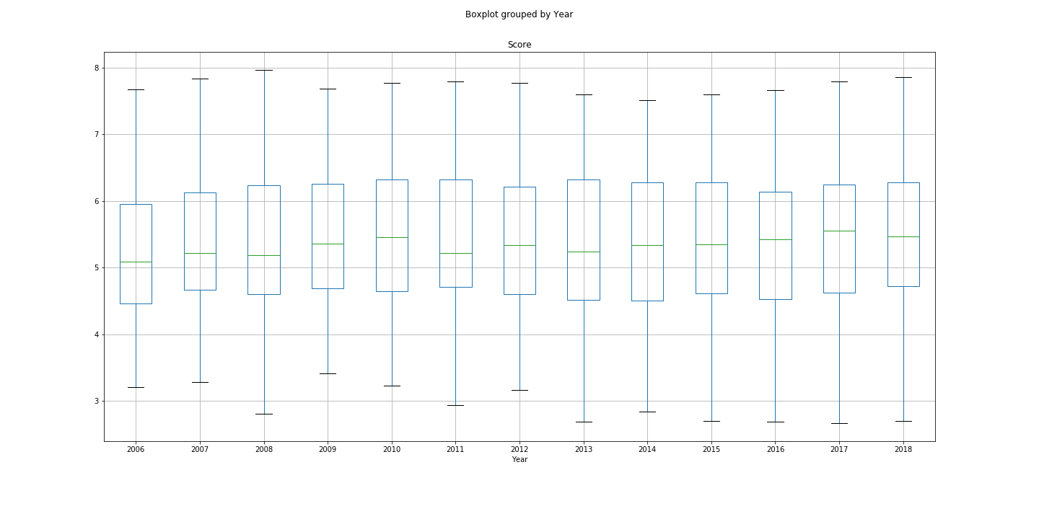
Global Happiness Trend
The overall happiness level hasn’t changed a lot…
Happiness Scores Grouped by Year (2006 ~ 2018)
Data : Gallup(2006~2018) ‘World Happiness Report’

Slide 11
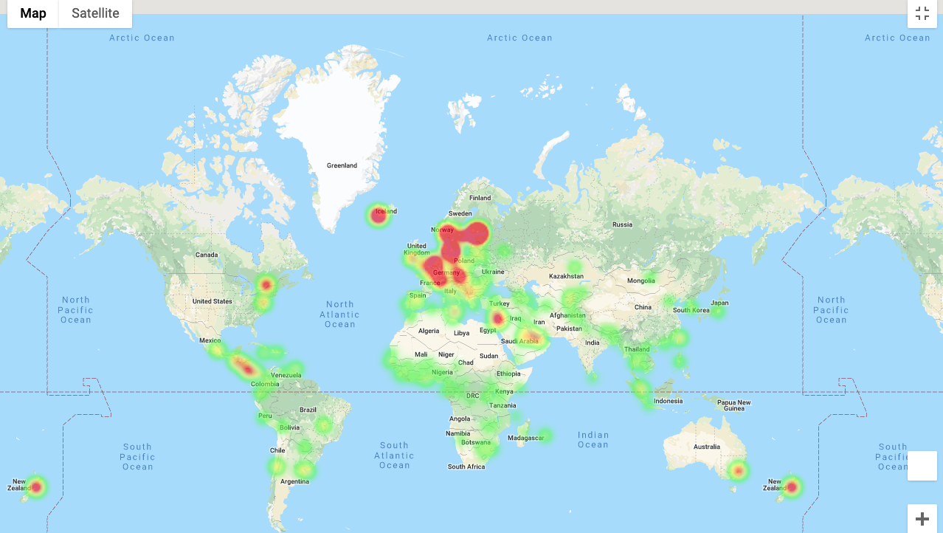
What are the ‘Happiest’ Countries?
The Lucky Ones are Finland, Denmark, Norway, Iceland, Netherlands,
Switzerland, Sweden, New Zealand, Canada, Austria, Australia…
Happiest Countries in the World (Capital Cities)
Data : Gallup(2019) ‘World Happiness Report’ / Google Maps API

Slide 12
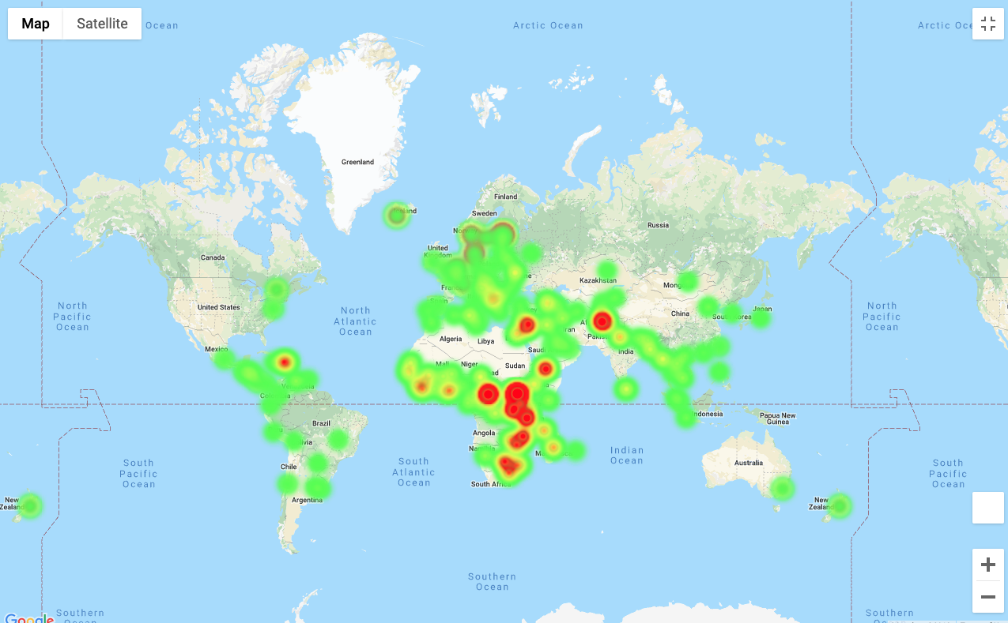
What are the most ‘Miserable’ Countries?
They are South Sudan, Central African Republic, Afghanistan, Tanzania,
Rwanda, Yemen, Malawi, Syria, Botswana, Haiti, Zimbabwe, Brundi…
Most Miserable Countries in the World (Capital Cities)
Data : Gallup(2019) ‘World Happiness Report’ / Google Maps API

Slide 13
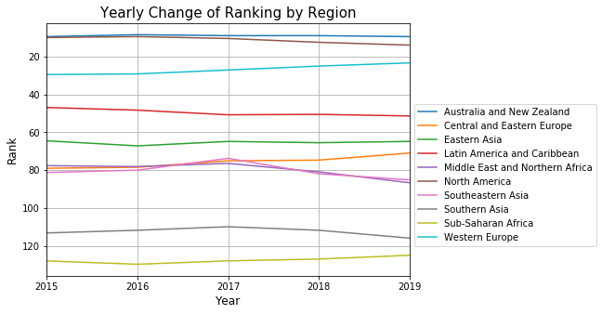
Regional Trend
But, Look at all the differences by region!
Yearly Change of Ranks by Region
Data : Gallup(2015~2019) ‘World Happiness Report’

Slide 14
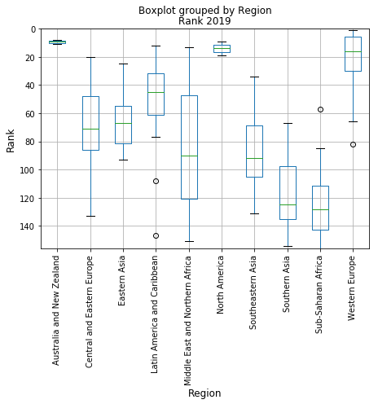
Regional Variance in 2019
Variances also differ by region!
Boxplot Grouped by Region Rank 2019
Data : Gallup(2019) ‘World Happiness Report’

Slide 15
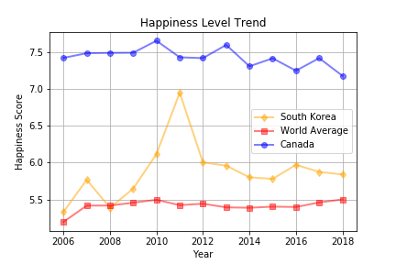
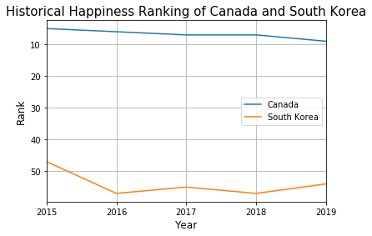
Any Specific Interest?
Want to know more about each country?
Happiness Level Trend of Canada and South Korea
Data : Gallup(2006~2018) ‘World Happiness Report’ / Gallup(2015~2019) ‘World Happiness Report’

Slide 16

II. What ‘Factors’ Correlate More
With the Level of Happiness?

Slide 17
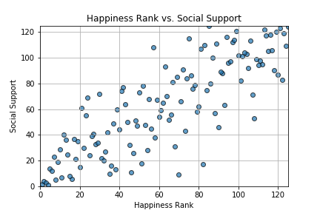
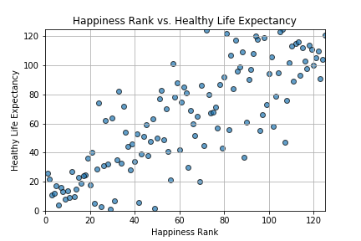
Factor Correlation Analysis
Social Support and Life Expectancy are highly correlated with Happiness
1) Social Support
2) Healthy Life Expectancy
Data : Gallup(2019) ‘World Happiness Report’

Slide 18
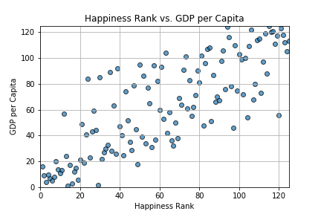
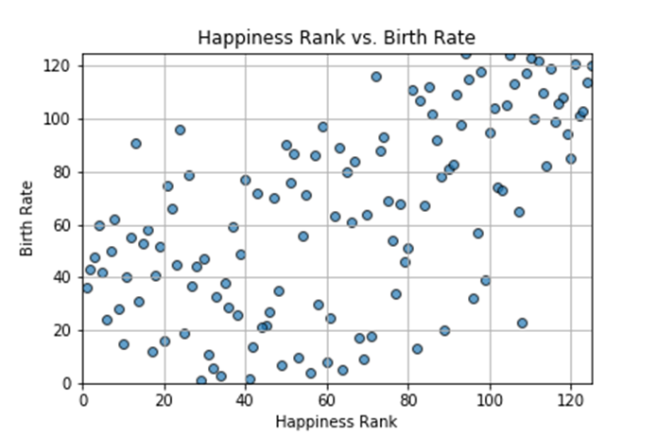
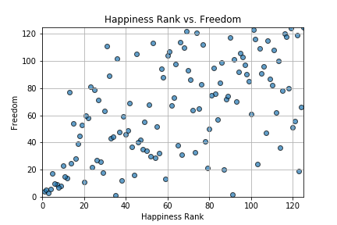
Factor Correlation Analysis
GDP, Birth Rate, and Freedom are moderately correlated with Happiness
3) GDP per Capita
4) Birth Rate
5) Freedom
Data : Gallup(2019) ‘World Happiness Report’ / CIA(2018) ‘Birth Rate’

Slide 19
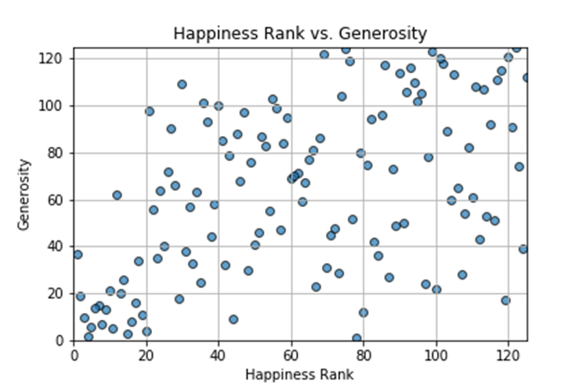
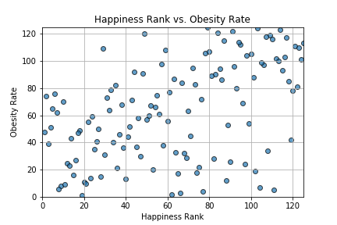
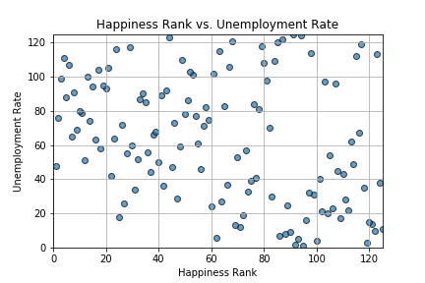
Factor Correlation Analysis
Generosity, Obesity, Unemployment show low correlation with Happiness
6) Generosity
7) Obesity Rate
8) Unemployment Rate
Data : Gallup(2019) ‘World Happiness Report’ / CIA(2016) ‘Birth Rate’ / CIA(2017) ‘Unemployment’

Slide 20
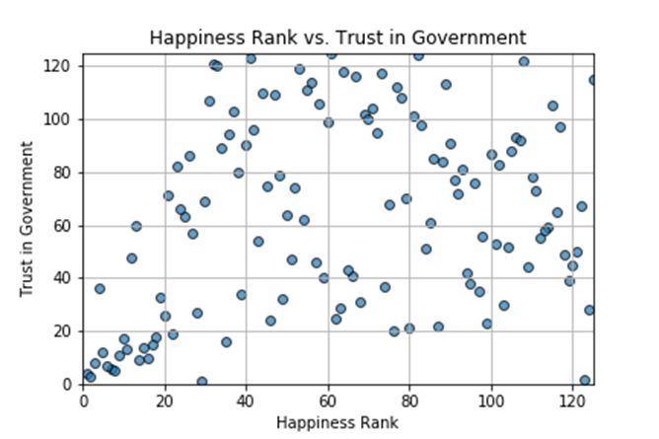
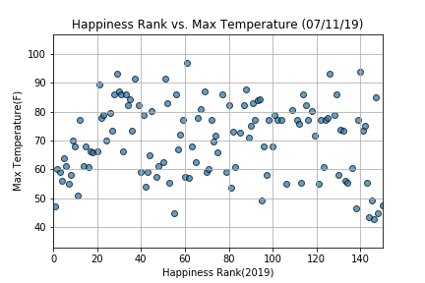
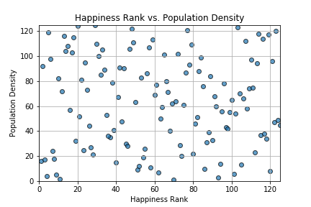
Factor Correlation Analysis
Obviously, Thanos is wrong!! Look at the Population Density!
9) Trust in Government
10) Temperature
11) Population Density
Data : Gallup(2019) ‘World Happiness Report’ / CIA(2018) ‘Population’, ‘Area’ / World Bank API & OpenWeatherMap API for ‘Weather’

Slide 21
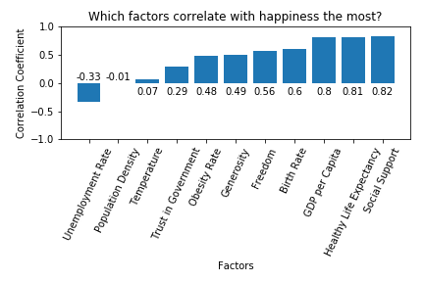
Correlation Coefficient Summary
Tada! Here come all the numbers!

Slide 22

III. Why and How are the ‘Top Two Factors’
Strongly Related to Happiness?

Slide 23
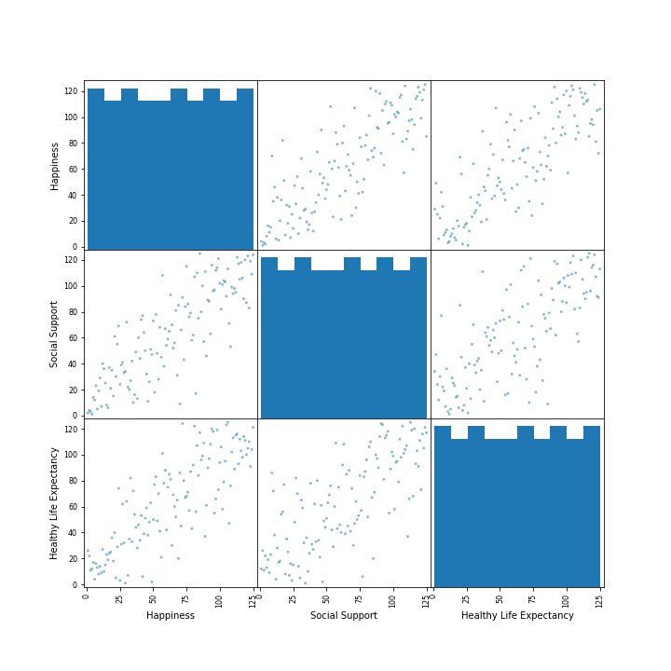
Delving into the Top Two
The top two factors and happiness itself are strongly correlated with each other!
Scatter Matrix (Happiness, Social Support, and Life Expectancy
Data : Gallup(2019) ‘World Happiness Report’

Slide 24
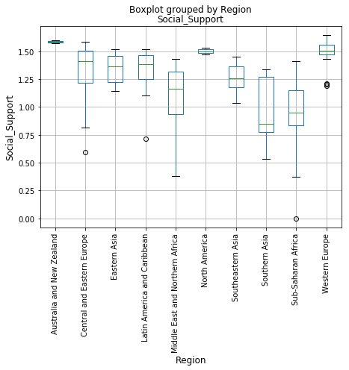
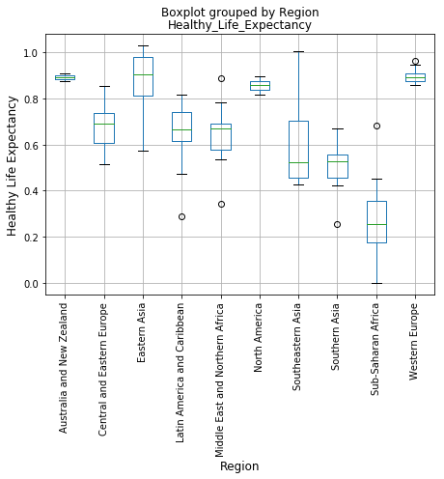
Delving into the Top Two
But, just like the happiness ranks, the top two factors show regional differences!
Social Support by Region (2018)
Life Expectancy by Region (2018)
Data : Gallup(2018) ‘World Happiness Report’

Slide 25
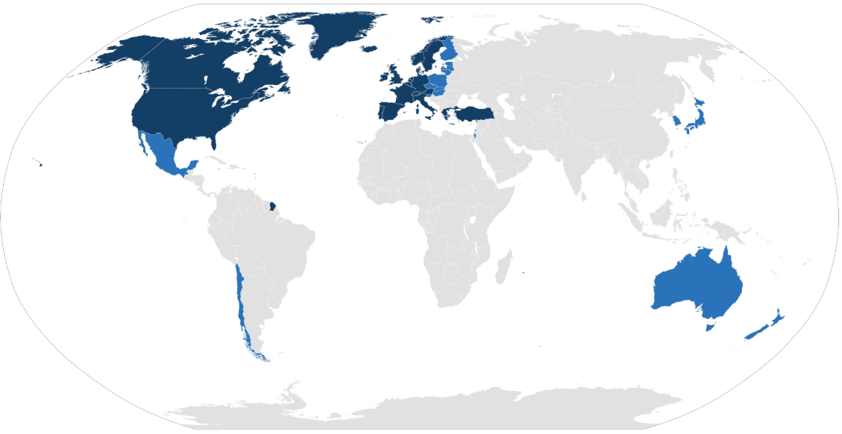
Delving into the Top Two – OECD Countries
Hmm…. I see your suspicious eyes…
Let’s focus on OECD countries and check the two factors out…
OECD Countries
Among 24 indicators…!
'Air pollution', 'Dwellings without basic facilities’, 'Educational attainment’,
'Employees working very long hours’, 'Employment rate’,
'Feeling safe walking alone at night’, 'Homicide rate’,
'Household net adjusted disposable income’, 'Household net wealth’,
'Housing expenditure’, 'Labor market insecurity', 'Life expectancy’,
'Life satisfaction’, 'Long-term unemployment rate', 'Personal earnings’,
'Quality of support network', 'Rooms per person', 'Self-reported health’,
'Stakeholder engagement for developing regulations’, 'Student skills’,
'Time devoted to leisure and personal care’, 'Voter turnout’,
'Water quality', 'Years in education'
Data : OECD Stats Data(2019)

Slide 26
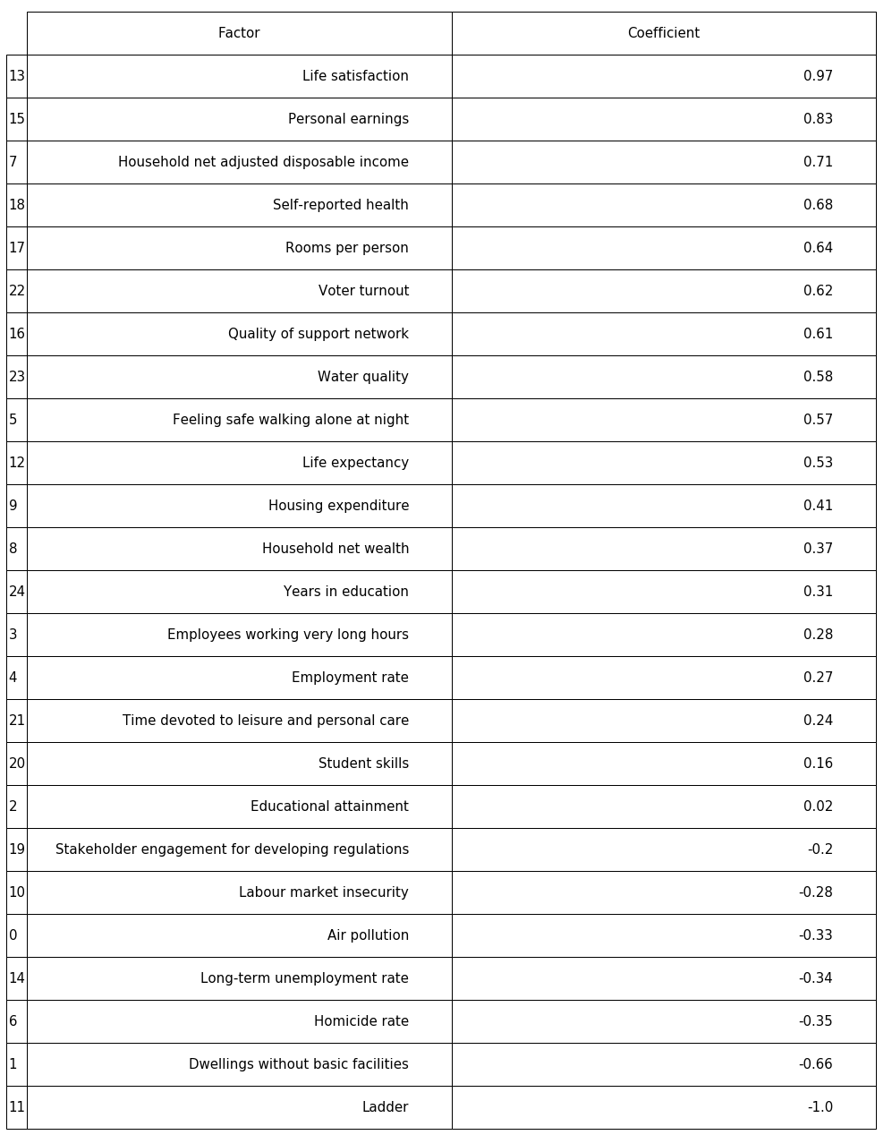
Delving into the Top Two – OECD Countries
And here they are! What do you think about the result?
Above 0.5 Coefficient Factors
Below 0.5 Coefficient Factors
Data : Gallup(2019) ‘World Happiness Report’ / OECD Stats Data(2019)

Slide 27
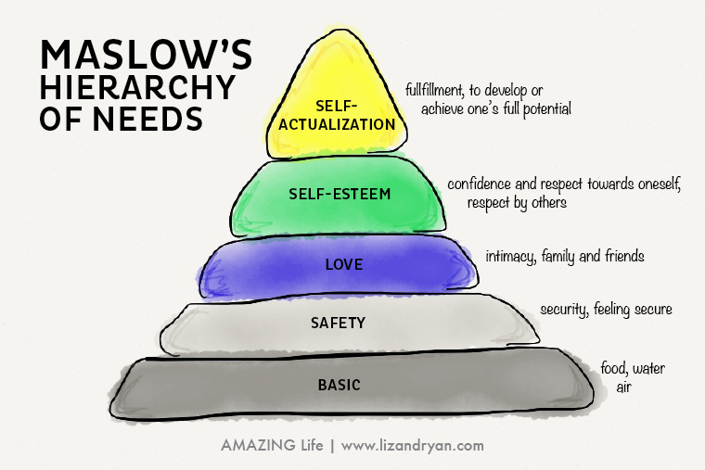
Delving into the Top Two
This old psychological theory might tell you something…
Maslow’s Hierarchy of Needs

Slide 28
Questions?
Thank you!

